Slide 1

Microsoft 365 Connected to Sentinel
Cost Comparison & Key Takeaways
Anthony Zatika
Notes:
Hello, welcome to my last presentation. For this week, I will show the process of connecting Microsoft 365 to Microsoft Sentinel. I will explain the pricing and give my key takeaways.

Slide 2

Agenda
Microsoft 365 Defender
Connecting 365 Defender to Microsoft Sentinel
Cost of 365 Defender
Recommendations
Conclusion
Notes:
For today’s Agenda, I will explain the reason for using Microsoft 365 Defender and its capabilities. Next, I will address the process of setting up Microsoft 365 Defender and connecting it to Microsoft Sentinel. Next, I will take a deep-dive into the costs of the applications. I will follow up with my recommendations and my conclusion.

Slide 3

Introduction
Microsoft 365 Defender stops attacks across Microsoft 365 services
Microsoft 365 Defenders offers integrated threat protection with SIEM and XDR
Microsoft 365 Defender is well recognized keeping identities, endpoints, cloud applications, and email/documents safe
Notes:
Microsoft 365 Defender is an industry leader in stopping attacks across all its services and devices. It has the capability of integrating with SIEM and XDR tools for SOAR (Security Orchestration, Automation, & Incident Response). Microsoft 365 Defender is well recognized for providing safety to identities in access management, endpoints, cloud applications, and emails/documents. Microsoft 365 Defender achieves this protection through, preventing cross-domain attacks and persistence, reducing incident response signal noise, Auto-healing affected assets, and hunting threats across domains.

Slide 4
Why Sentinel + Defender
Microsoft 365 Defender needs visual representation
Correlation, Aggregation, & Threat Response
Easy to use data for other purposes
Notes:
Microsoft 365 Defender needs to be paired with Sentinel for a couple of reasons. For instance, Microsoft 365 Defender needs its output data to be represented visually. Through Sentinel’s dashboard, you can see where threats are located and fully understand how an attack is taking place in real-time. Microsoft 365 Defender also needs correlation, aggregation & threat response assistance. The platform can not automate real-time responses. Last, the data collected by Sentinel can be exported or transported into a proprietary software to be used in other ways.

Slide 5

Connection Process
Microsoft 365 Defender sends data to Microsoft Sentinel
Notes:
Now, I will get into the heart of the presentation. I will show you a step-by-step guide to connect Microsoft 365 Defender to Sentinel. This is an extremely easy process, and it does not require any coding or special knowledge. The only caveat is that you will need either a Microsoft 365 E3 or E5 license. For this presentation I attempted several times to speak with Microsoft’s sales team, but due to the overly complicated and slow process of responding to my communications, I was unable to get a free trial. However, I can show everyone the setup steps until I get to the final stage in which I would need the license to fully activate the connection.

Slide 6

In Microsoft Sentinel
Navigate To The Data Connectors Tab
Notes:
First, when logged in and looking at the Microsoft Sentinel page, you need to find the data connectors tab.

Slide 7
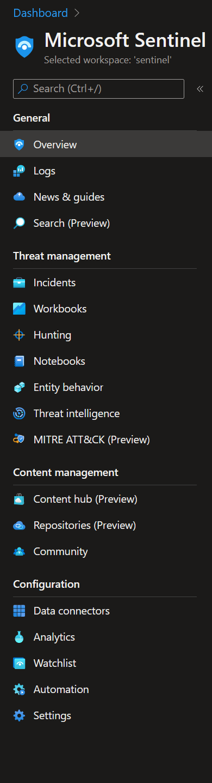
In Microsoft Sentinel
Find the fifth tab called “Data Connectors”
Notes:
The Data Connectors tab will be the fifth from the bottom. You would need to click that tab.

Slide 8
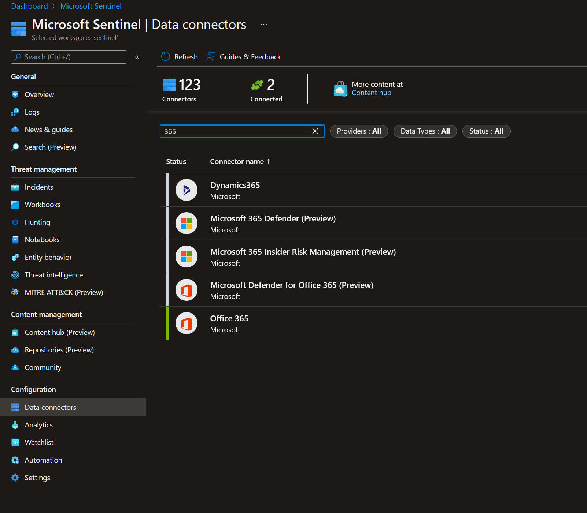
In Data Connectors
Notes:
Now, you are in the Data Connectors tab. In the search box, type “365” and you will see these option choices appear. Select the “Microsoft 365 Defender” from the list. You will subsequently select the connect button to allow all permissions and connections to go through.

Slide 9

Cost of 365 Defender
Let’s dive in
Notes:
Now, I wanted to get into the costs of 365 defender.

Slide 10
Cost Comparison
Notes:
For Microsoft 365 Defender there are two packages available, but one needs to be purchased to enable the connector. The pricing on the packages are not that steep, keeping in mind that these will protect all aspects of your enterprise/business. The first package is Microsoft 365 Enterprise 3. This is 36.00/month per user and, of course, will provide access to most of the essential functions. If you need access to compliance management, information protection, threat protection, IAM and advanced analytics you should get Microsoft 365 Enterprise 5. This package is 57.00/month per user, but it will enable access to connecting Microsoft 365 Defender to Microsoft Sentinel.

Slide 11
Recommendations
Improving Cost/Protection
Notes:
As far as recommendations go, I would rather use services such as AWS for hosting virtual services because these can be monitored with ease. I am sure that Microsoft being as big of a company as it is offers exceptional service, but I was not able to witness it yet.

Slide 12



Summary
Easy Steps
Click through a couple of tabs to activate
Cost
Microsoft E3 only costs $36.00/month per user
Microsoft E5 only costs $57.00/month per user
Slow
I could not get a license even with constantly sending emails and taking calls
Notes:
In summary, connecting Microsoft 365 Defender to Sentinel is an easy process, there are very few steps, and the monitoring happens instantly once connected. However, due to Microsoft’s partners taking so long to reply and speak with me (I am sure that they are busy), I was unable to obtain a license or a free trial to showcase the setup. Perhaps I can still try to gain a license and update this presentation and send it over email to reflect a more substantial outcome.

Slide 13

Conclusion
Thank You,
I hope you enjoyed my presentation
Notes:
Thank You, I hope that you enjoyed my presentation. If you have any questions, feel free to ask me.

Slide 14
References
Yelevin. (n.d.). Microsoft 365 Defender Integration with Microsoft Sentinel. Microsoft Docs. Retrieved August 18, 2022, from https://docs.microsoft.com/en-us/azure/sentinel/microsoft-365-defender-sentinel-integration
Dansimp. (n.d.). Microsoft 365 Defender Integration with Microsoft Sentinel. Microsoft Docs. Retrieved August 18, 2022, from https://docs.microsoft.com/en-us/microsoft-365/security/defender/microsoft-365-defender-integration-with-azure-sentinel?view=o365-worldwide
Office 365 E5. Microsoft. (n.d.). Retrieved August 18, 2022, from https://www.microsoft.com/en-us/microsoft-365/enterprise/office-365-e5
Office 365 E3. Microsoft. (n.d.). Retrieved August 18, 2022, from https://www.microsoft.com/en-us/microsoft-365/enterprise/office-365-e3?activetab=pivot%3Aoverviewtab
Microsoft defender for office 365. Microsoft Security. (n.d.). Retrieved August 18, 2022, from https://www.microsoft.com/en-us/security/business/siem-and-xdr/microsoft-defender-office-365

